Slide 1

PyTravel
Frank Lau
Monique Ferguson
Marcela Castaño

Slide 2

Motivation
Early on, we decided we wanted to integrate data from free APIs into our project.
We explored a couple different sources and settled on using available APIs on RapidAPI.com
Travel data sparked our attention the most
“There’s lots we can analyze here” we thought to ourselves, and we were right!
There will be lots of puns arriving soon, but we are experiencing some delays.
We found dedicated APIs for flights, hotels, car rentals, parks & trails, points of interest, etc.

Slide 3
Objectives
All-in-one travel planner powered by FinTech
Estimate travel budget, find out travel restrictions at intended destination, and survey hotel reviews
Learn more about the tourism industry

Slide 4
A Solution…Trichotomy?
How do we generate a travel itinerary?
We started out with the idea of “selling an experience”. Our plan was to provide a full vacation package for imaginary customers using API data. This plan was ambitious, and so, in the end, we narrowed it down to provide flight and hotel quotes for a single customer.
Which travel destinations should we consider?
The idea of generating a travel package quickly led us to consider current travel restrictions due to COVID-19. We decided it was imperative we shared a summary of these restrictions to our imaginary customer.

Slide 5
A Solution…Trichotomy?
What do we know about the tourism industry?
At some point, we found statistics on tourism worldwide. This seemed like an interesting dataset that we could incorporate into our project.
This is when we decided that our travel agency was interested in analyzing customer-focused data and agency-focused (or internal) data.

Slide 6
Questions
Tourism Analysis
How has worldwide travel progressed over the years?
Data from https://data.worldbank.org/indicator/ST.INT.ARVL
From geopy.geocoders we imported Nominatim to retrieve latitude and longitude
Which Continents Are The Most Travelled To?
Data from https://data.worldbank.org/indicator/ST.INT.ARVL
From geopy.geocoders we imported Nominatim to retrieve latitude and longitude
How did COVID-19 affect the rate of travel in the USA?
Data from https://www.tsa.gov/coronavirus/passenger-throughput
Where do sharks go when they want a vacation? Finland.

Slide 7
Questions
COVID-19 Travel Restrictions
How has COVID-19 affected international travel from the United States?
Data from https://www.kayak.com/travel-restrictions
What are some of the travel restrictions that have been implemented due to COVID-19?
Data from https://www.kayak.com/travel-restrictions and https://www.naturalearthdata.com/downloads/10m-cultural-vectors/
From geopandas we imported descartes to plot polygons. We also imported Bokeh
Do you know why many people love going to South Korea? To find their Seoul mates.

Slide 8
Questions
Travel Planner
What are the flight options available for the client's intended destination?
Skyscanner API endpoint @browse quotes to obtain Airline and Price data
https://rapidapi.com/skyscanner/api/skyscanner-flight-search/
What is the hotel availability in the destination of interest?
Booking.com API endpoint @Search locations to return number of hotels in 5 areas(e.g. districts) in the city of choice.
https://rapidapi.com/tipsters/api/booking-com/
Czechs do not have time to waste. They are very Prague-matic.

Slide 9
Questions
What are some of the hotel options? How do these compare to each other in price and quality?
Booking.com API endpoint @Search hotels to return hotel prices, reviews, physical address, etc. in the area of choice. This requires a destination_id obtained with @Search locations endpoint.
https://rapidapi.com/tipsters/api/booking-com/
How can we compare hotel locations with other points of reference?
Folium Library to generate an interactive map with icons for each hotel
http://python-visualization.github.io/folium/
I’d like to know why the winters are so cold in America. I think Alaska local.

Slide 10
Data Cleanup and Exploration
Tourism Analysis
For information on international tourism travel, we downloaded data from worldbank.org. This data set included the number of arrivals per year for each country up to 2019.
Then we used geopy to append the latitude and longitude of each country into the data frame. Again, we used a for loop for this.
The latitude and longitude columns were moved from the end of the column list. They were placed after the countries but before the year 1995.
The melt function was used to unpivot the data frame from wide format to long format. Afterward, there was only one column that contained year values.
From this data, we inferred that international travel has generally increased each year. However, there were slight dips in 2003 and 2009, which could be due to the Iraq war and the recession of 2008.
The scatter geo and bar chart showed how the number of arrivals changed each year. The pie chart shows the percentage of visitors to each continent.
For USA-specific information, we imported a TSA chart (https://www.tsa.gov/coronavirus/passenger-throughput), and the nulls were dropped. In addition, a line chart was produced which showed that in 2020 visitor travel plummeted compared to the 2019 year.

Slide 11
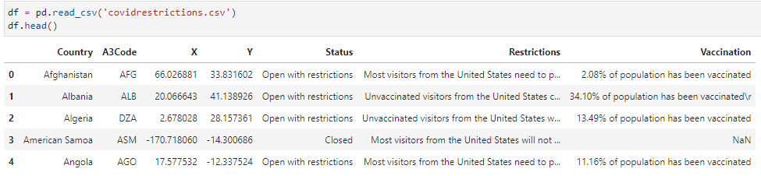
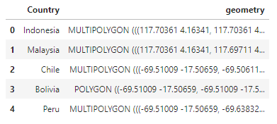
Data Cleanup and Exploration
Covid-19 Travel Restrictions
In order to create the interactive map, we needed data on travel restrictions. In order to do this, we manually scraped data from https://www.kayak.com/travel-restrictions into a dataset called covidrestrictions.csv. This csv file contains Country information, A3 Codes, X and Y coordinates, COVID-19 travel requirements, and population vaccination percentages.
Regarding the interactive map, we decided to use the package Geopandas and the python library Bokeh. These packages use polygon based shapes to form boundaries and layouts of different maps. Because we are creating a global map, we downloaded and utilized large scale cultural vectors provided from https://www.naturalearthdata.com/downloads/10m-cultural-vectors/.
After acquiring the two sets of data needed, we merged covidrestrictions.csv with the shape data. Using the merged dataframe, we proceeded to use bokeh functions to create and customize the interactive map.
To optimize the merged data, we needed to explode the dataframe to convert multipolygons to polygons in order to avoid country boundary overlap.
After customizing and prepping the plot, we finalized the plot by exporting it as an html. Hovering over individual countries will show the country name, status, restrictions, and population vaccination percentages if available.

Slide 12
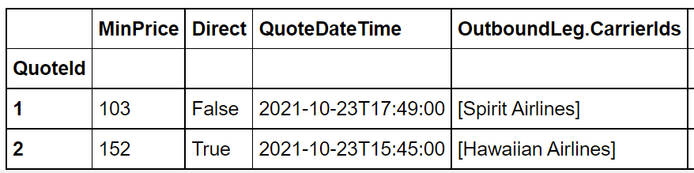
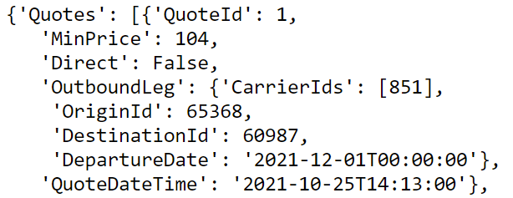
Data Cleanup and Exploration
Travel Planner
Flights
Used Skyscanner API at RapidAPI.com
Created .py file for request details and ran request on notebook by calling .py file
Created loop that can retrieve multiple quotes from the API response
Created dataframe with relevant variables
Used json_normalize to expand nested fields
Because each quote could contain more than one carrier, the carriers were returned as a list. A loop was created to turn lists into strings. This was important at the time of plotting.
Generated plots with .plot, .px, .hvplot to decide on style
Plotly express and hvplot could not handle lists as x-values.

Slide 13
Data Cleanup and Exploration
Travel Planner
Hotels
Booking.com API
@ Search Locations endpoint:
Created .py file for request details and ran request function on notebook
Saved response as a dataframe and dropped non-relevant columns
Used map box to plot the number of hotels in each “location”
This endpoint returned cities and districts as “locations” with hundreds or thousands of hotels within it, but would sometimes return a single hotel as a location. Read: Paid ad.
@ Search Hotels endpoint:
Created .py file for request details and ran request on notebook by calling .py file
Used a random location from the first endpoint to search for hotels around that location
Generated a dataframe with the hotel results
Used scatter plot to compare pricing vs. hotel review score
Printed and outputted hotel quotes as a .txt file
Folium Library
Mapped the hotels in the area. Added a ‘bed’ icon to each hotel on the map.

Slide 14
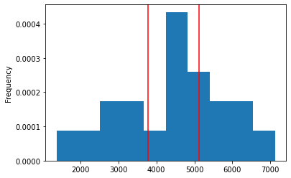
Data Cleanup and Exploration
Travel Planner
Hotels
This plot was made to analyze the 95% confidence interval of hotel prices.
This plot is not intended to be seen by the imaginary client, but it provides an overview of how much should hotel expenses vary for the trip scenario.

Slide 15

Data Analysis & Discussion

Slide 16
Data Analysis & Discussion
Tourism Analysis
How has worldwide travel progressed over the years?
First, we needed to look at the number of arrivals for each country in each continent per year. Using a bar graph allowed us to visualize this data and conclude that worldwide travel increases due to increases in the number of arrivals each year.
From 1995 to 2019, the scatter geo shows that international visitor travel increases just about every year for all continents.
As the animation plays, we see that each point increases year to year, which signifies the number of arrivals.

Slide 17
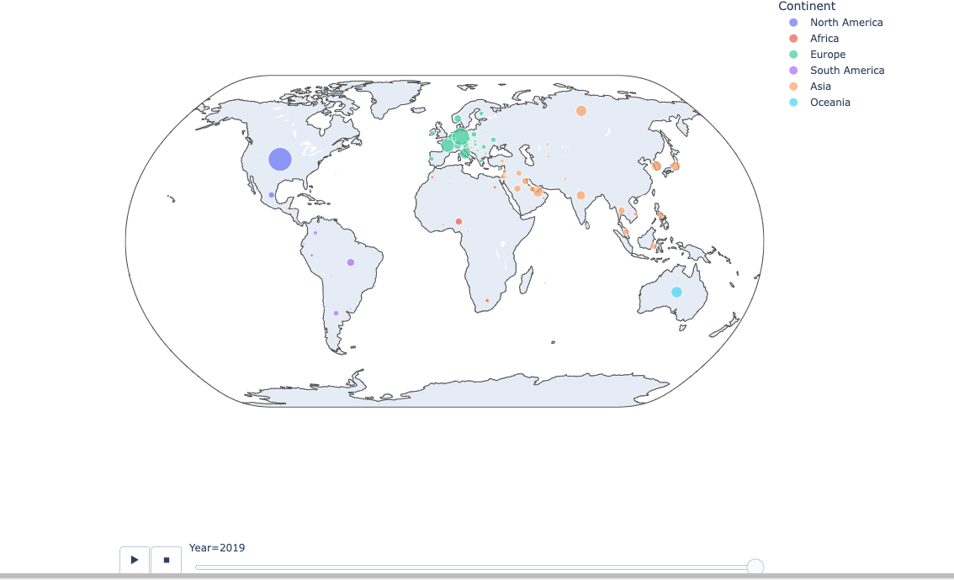

Slide 18
Data Analysis & Discussion
Tourism Analysis
Which continents are the most traveled to?
We created a pie-chart that displayed the percentages of travel to each continent.
The pie chart shows that visitors travel most to Europe (38%), Asia (30.5%), and North America (20.1%).
The bar chart shows the progression throughout the year. There has generally been an increase each year from 1995 – 2019

Slide 19
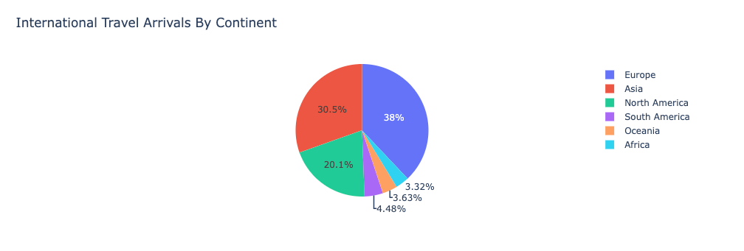
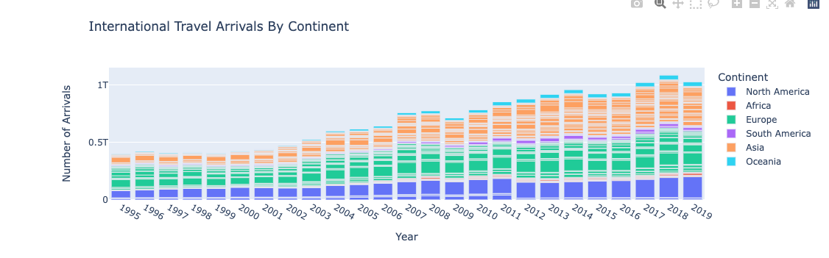

Slide 20
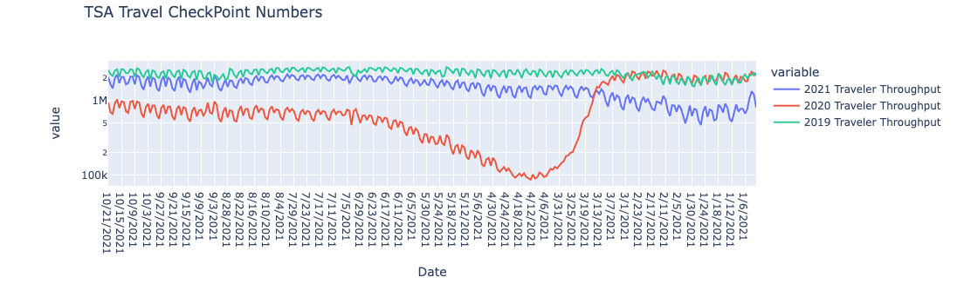
Data Analysis & Discussion
Tourism Analysis
How did COVID-19 affect the rate of travel in the USA?
A line chart was suitable for showing this data retrieved from the TSA website.
When compared to 2019 and 2021 data, the line for 2020 showed a significant decrease.

Slide 21
Data Analysis & Discussion
COVID-19 Restrictions
How has COVID-19 affected international travel from the United States?
As a result of COVID-19, travel to international countries was categorized as either fully Open, Open with restrictions, or Closed. This is because international governments have enacted certain travel bans and restrictions depending on your country of origin.
An interactive map was the best method to visualize the data. The legend of the map helps breaks up the countries into three categories and colors, green for "Open," orange for "Open with restrictions," and red for "Closed."

Slide 22
Data Analysis & Discussion
COVID-19 Restrictions
What are some of these travel restrictions that have been implemented due to COVID-19?
Currently, most countries are in the category "open with restrictions." These countries require either mandatory vaccinations, quarantines, and COVID-19 PCR or antigen tests. Additionally, depending on the host nation, mandated quarantines can last up to a week or more, making short vacations to some of these countries illogical.
Hovering over specific countries in the map will show current available data pertaining to individual country travel rules and restrictions in addition to vaccination percentages.

Slide 23
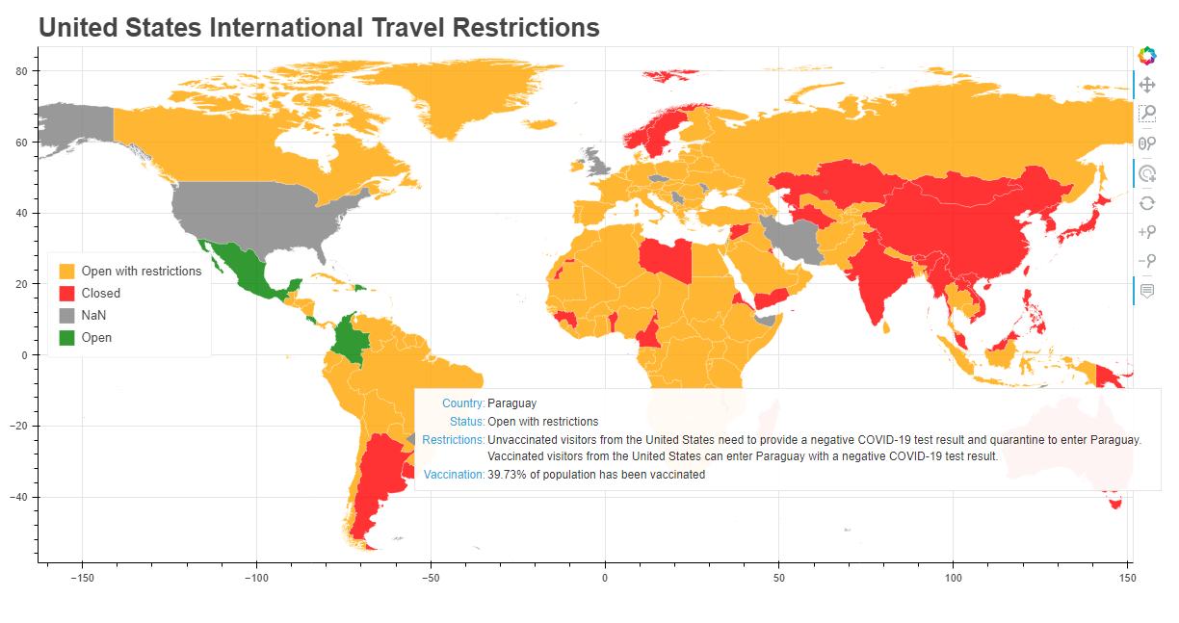

Slide 24
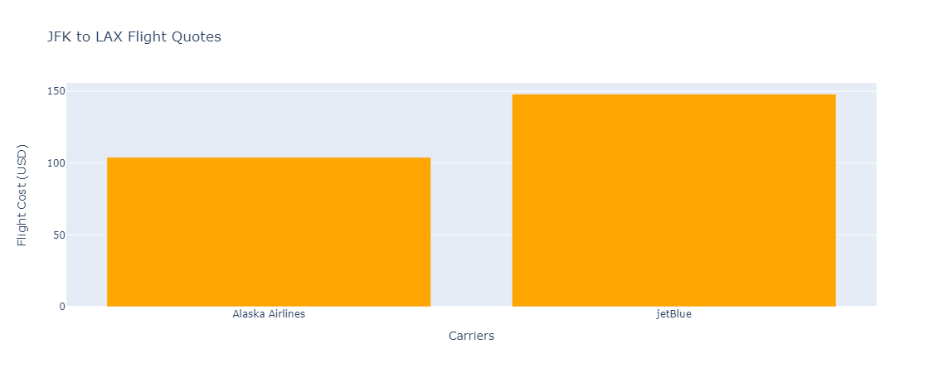
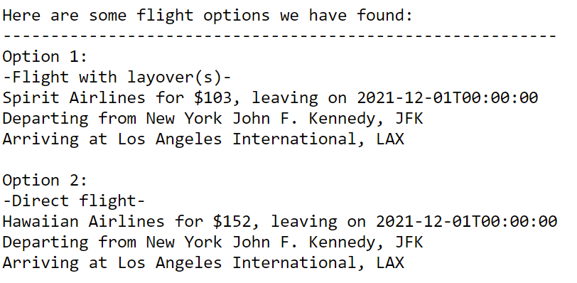
Data Analysis & Discussion
Travel Planner
What are the flight options available for the client's intended destination?
Generated plot for all quotes
Hovering over the graph will show exact price, carrier and if the flight is direct or not.
Printed and outputted flight quotes to a .txt file
The graph and print quotes will allow the imaginary customer to pick a flight based on price, carrier or direct flight to destination.
Skyscanner API had trouble finding flights for lots of medium and large sized airports

Slide 25
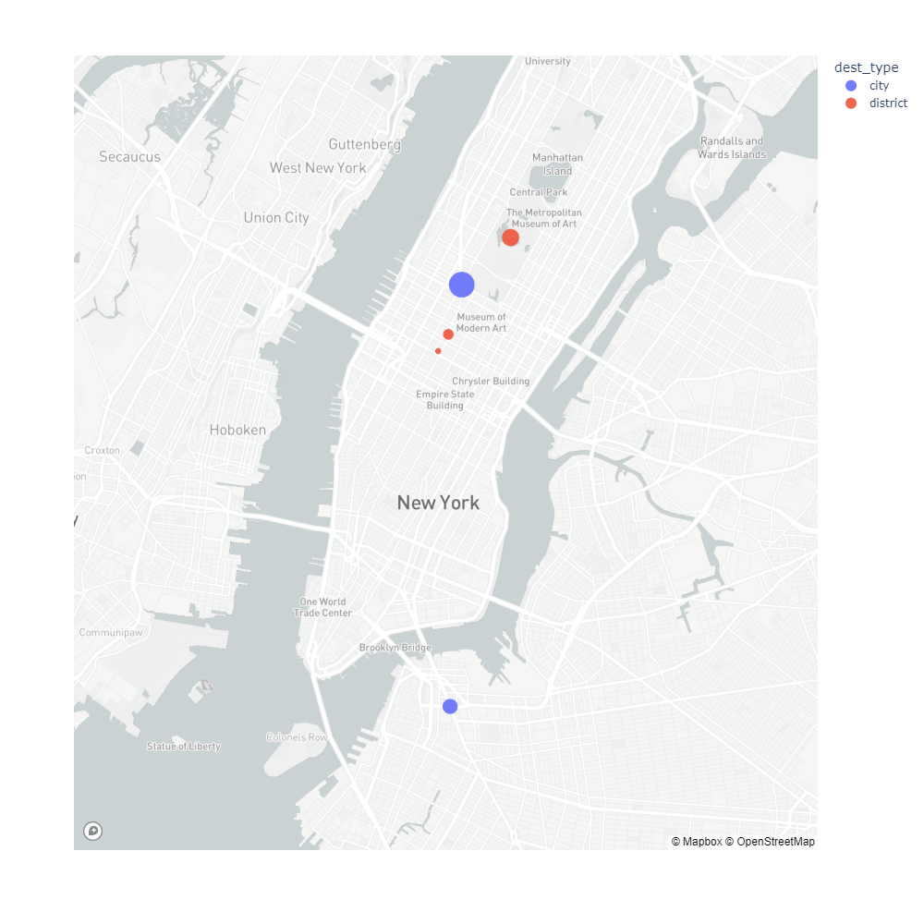
Data Analysis & Discussion
Travel Planner
What is the hotel availability in the destination of interest?
API would always return 5 different locations. For the most part these were districts, cities or singular hotels.
In this particular plot, New York City and Manhattan (district) have the largest amount of hotels available.

Slide 26
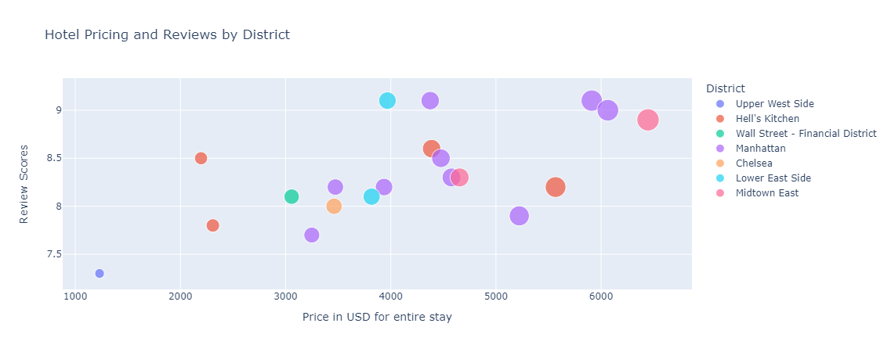
Data Analysis & Discussion
Travel Planner
What are some of the hotel options? How do these compare to each other in price and quality?
A random location from the locations dataframe was selected. Running the @Search Hotels endpoint then retrieves 20 hotel options near the selected location.
In this particular plot, we can see there are several options around a rating of 9.0★ ranging from $4000-$6500. On the other hand, hotels cheaper than $3000 received a score between 7.0-8.5★.

Slide 27
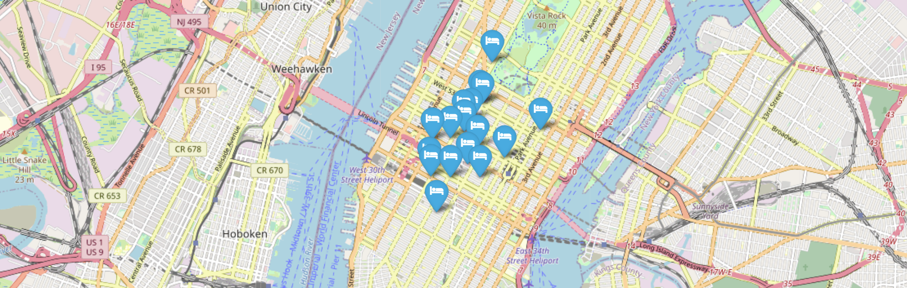
Data Analysis & Discussion
Travel Planner
How can we compare hotel locations with other points of reference?
This interactive map allows the customer to pick a hotel based on their respective location in the city of choice. By hovering over the icon, the name of the hotel is displayed, if they click on it, they can see the hotel’s rating.

Slide 28
Post-Mortem
Challenges
Working with GeoPy for the first time and creating a for loop to print out countries that GeoPy did not recognize. These "countries" were regions and had to be deleted from the data frame
Skyscanner presented challenges with finding quotes for a handful of large airports. Initially, we had developed a dataframe with IATA codes for airports around the world. The idea was to randomly choose a set of airports and run the SkyScanner and Booking.com APIs with this data, but it proved to be unreliable at acquiring quotes for flights.
Being new to geopandas, some country shape files such as the United Kingdom came out as NaN even though the available data in the csv file was accurate. Updating the csv file did not change anything either. With more time, we would be able to look into the shape files to identify if the error is there or find updated shape files.
What would we research next?
We would look into specific country data and identify more tourist visitations throughout the years with more time
Look at the most traveled areas and for potential trends to show up and coming popular travel destinations
How to integrate our concept into a website or app

Slide 29
Appendix
List of APIs
Mapbox
SkyScanner
Booking.com
List of New Python Libraries
GeoPy
Geopandas
Bokeh
Random
Folium
Simple_colors
Scipy.stats
Works Cited
https://viatravelers.com/travel-puns/
https://www.tsa.gov/coronavirus/passenger-throughput
https://data.worldbank.org/indicator/ST.INT.ARVL

Slide 30

Questions?

